Slide 1
Server-side Web Development
HTML

Slide 2
HTML
Web pages are written in HyperText Markup Language.
With HTML
formatting information is included in text documents.
hyperlinks are also embedded in the document as text.
HTML 4.01 -W3C Recommendation 24 Dec 1999.
Available at
http://www.w3.org/TR/html401 (HTML 4 only)
[HTML5 now released.
http://www.w3.org/TR/html5/

Slide 3
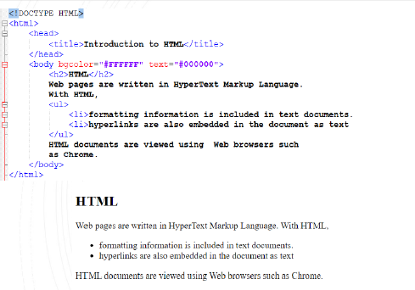
HTML Example

Slide 4
HTML Elements
Examples of elements in HTML are
paragraphs, lists hypertext links, tables etc. etc.
Elements appear in an HTML document as
<tagname> content </tagname>
Sometimes end tags can be omitted.
Depends on DOCTYPE
<br> correct for HTML, <br/> correct for XHTML
Sometimes there is no content (e.g. line break <br>)
We have already seen <html>, <title>, <body> ….

Slide 5
HTML Attributes
Elements have associated properties called attributes, which may have values.
Attribute/value pairs appear before the “>” of the start tag.
Attribute value pairs are separated by spaces and can appear in any order.
Attribute values can be delimited using either single or double quotes.
<bgcolor=“#ffffff” text=“#000000”>

Slide 6
HTML Attributes
If the attribute value contains only alphanumeric, hyphens, periods, underscores and colons, the quotes can be omitted. XHTML requires quotes always
The HTML specification recommends always using quotes.
Safest is to always use quotes!

Slide 7
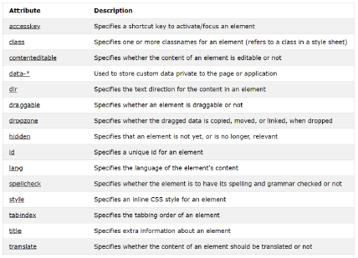
HTML Global Attributes (any HTML element)

Slide 8
HTML Comments
Comments start with special <!--and end with -->tags
Everything between these tags is considered a comment even over multiple lines.
<!-- this is a comment -->
<!-- this is a comment
over multiple lines -->
Highlight and CTRL –SHIFT –C in Eclipse will put in comments. (Most IDE’s with have similar shortcuts)

Slide 9
HTML Colours
Colours are represented as six digit hexadecimal numbers preceded by # character.
#FFFFFF, #09AB4E
These are actually three 2 digit numbers representing the amount of Red, Green and Blue in the colour.
There are also a set of well known colour names
https://www.w3schools.com/colors/colors_names.asp
Lots of online (and IDE integrated) tools to help choose/visualise HEX colour values
https://www.w3schools.com/colors/colors_picker.asp

Slide 10
HTML Body Element
The <body> tag defines the document's body.
The <body> element contains all the contents of an HTML document, such as text, hyperlinks, images, tables, lists, etc.
Attributes
background-The value of this attribute is a URL that designates an image.
color–The colour of the background for the document.
text-This attribute sets the foreground colour for text
alink–The colour of the active hypertext link
link-This attribute sets the colour of text marking unvisited hypertext links
vlink-This attribute sets the colour of text marking visited hypertext links

Slide 11
HTML Div Element
The <div> tag defines a division or a section in an HTML document.
The <div> element is often used as a container for other HTML elements to style them with CSS or to perform certain tasks with JavaScript
Attributes
align–Specifies the alignment of the content inside the <div> element. Valid values (left, right, center, justify)
<div style=“background-color:lightblue”>
<p> this is a paragraph </p>
</div>
Tip – div is often used with CSS to help layout the page

Slide 12
HTML Text
Headings
There are six levels of headings from h1 to h6.
<h1>Text of heading</h1>
Start and end tag are required
Paragraphs
<p> Text of paragraph </p>
Line Break has no end tag.
<br>
Horizontal Rule (line) has no end tag.
<hr>

Slide 13
HTML Ordered vs Unordered Lists
<ol> defines an ordered list – numeric (including roman numbers) or alphabetical
<ul> defines an unordered list – bullet points
Need the <li> tag to define the list items
We can change the types of numbers or bullet points using style.
<ol>
<li>item 1</li>
<li> item 2</li>
</ol>
<ul>
<li>item 1</li>
<li> item 2</li>
</ul>

Slide 14


Style tags for ordered lists
<ol type="1">
<li>item 1</li>
<li> item 2</li>
</ol>
<ol type="A">
<li>item 1</li>
<li> item 2</li>
</ol>
<ol type="I">
<li>item 1</li>
<li> item 2</li>
</ol>
<ol type="a">
<li>item 1</li>
<li> item 2</li>
</ol>
<ol type="i">
<li>item 1</li>
<li> item 2</li>
</ol>

Slide 15



Style tags for unordered lists
<ul style="list-style-type:disc">
<li>item 1</li>
<ul style="list-style-type:circle">
<li> item 2</li>
</ul>
</ul>
<ul style="list-style-type:disc">
<li>item 1</li>
<ul style="list-style-type:square">
<li> item 2</li>
</ul>
</ul>
<ul style="list-style-type:circle">
<li>item 1</li>
<li> item 2</li>
</ul>
<ul style="list-style-type:disc">
<li>item 1</li>
<li> item 2</li>
</ul>
<ul style="list-style-type:square">
<li>item 1</li>
<li> item 2</li>
</ul>

Slide 16
HTML Images
The <img> tag defines an image in an HTML page.
The <img> tag has two required attributes: src and alt.
Note: Images are not technically inserted into an HTML page, images are linked to HTML pages. The <img> tag creates a holding space for the referenced image.
Tip:To link an image to another document, simply nest the <img> tag inside <a> tags.

Slide 17
HTML Images
<img src=“smiley.jpg” alt=“smiley face” width=“10%” height=“20%”>
<p> An image that is a link </p>
<a href=https://www.w3schools.com/><img src=“smiley.jpg” alt=“smiley face”></a>

Slide 18
HTML Links (Anchor tags)
Request
GET /myApp/insert?name=paul&address=Athlone
Header Fields
User-agent:Chrome/3.0.195.38
Host:Host
Accept:application/xml,application/xhtml+xml,text/html;q=0.9,
text/plain;q=0.8,image/png,*/*;q=0.5

Slide 19
HTTP POST - Example
Request Line
POST /myApp/insert
Header Fields
User-agent:Chrome/3.0.195.38
Host:Host
Accept:application/xml,application/xhtml+xml,text/html;q=0.9,
text/plain;q=0.8,image/png,*/*;q=0.5
Content-length:25
Empty Line
Body
name=paul&address=athlone

Slide 20
Web Resources
Static Web pages written in HTML.
The Web server reads the HTML file off the disk and sends it to the client (Web Browser).
Dynamic Page generated by a Web Application.
Often we don′t know (or care).

Slide 21
Web Application Frameworks
Java (lots)
PHP
C# and .net
Ruby (on Rails)
Groovy (& Grails)
Python (Django)

Slide 22
Web Application Frameworks - Java
Java Servlets is the basis for most Java based frameworks.
Java Server Pages (JSP) is often used with Servlets.
Apache Struts, JSF, GWT
Spring MVC (Model View Controller), Roo
Groovy and Grails
Java based as Groovy is completely interoperable with Java.
Grails based on the Spring Framework.

Slide 23
Web Servers – Java Support
Most Web servers are now also Servlet/JSP containers.
This means that they can:
accept GET and POST requests
start the appropriate Java servlet
pass data to the servlet for processing
accept HTML back from the servlet
pass it back to the client
(JSPs are compiled (translated) into Servlets.)

Slide 24
Terms – Web Server
Web Server
serve up Web pages (Apache)
most handle Java based Web Applications as well (Apache Tomcat)
became know as Application Servers

Slide 25
Terms – Application Server
Application Servers
Handle Java based Web Applications
Also started to provide much more, such as:
transaction support
security support
range of other services
JBoss, Glassfish, WebLogic, WebSphere

Slide 26
Terms - Container
We can think of the Application Server as a container which can contain:
Web Applications
Enterprise Java Beans (EJB) components
The Application Server can accept requests and pass them to the contained Web Application.
Servlet Container, EJB container, -most Application servers are both.

Slide 27
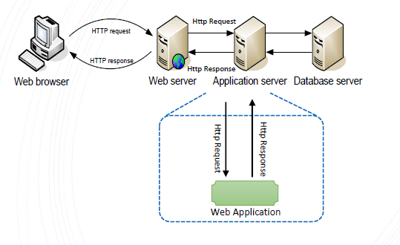
Application Server as a Container

Slide 28
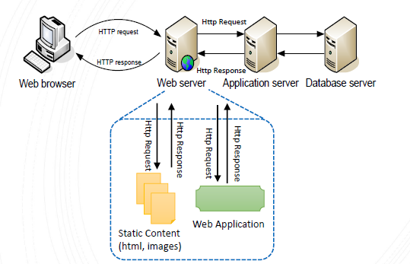
Alternatively – Web Application

Slide 29
Typical Web Applications in Java/Groovy
Some HTML pages.
Forms.
Form Processing Agents
Either Java Servlets and/or Java Server Pages (JSP) to process form data.
Or built on top of Servlets and developed using some Web Application Framework such as Grails.
Database backend.

Slide 30
J2EE Servlet Specification
Part of the J2EE specification
Java Enterprise Edition.
Specifies how a Web Application is deployed to a Web/Application Server such as Tomcat.
Typically the Application Server is going to expect resource files to be in a certain location.
So when we develop our Web applications, we are going to use a quite specific directory structure for that Web Application.

Slide 31
WAR File
Packaging for a Web Application.
WAR –Web Archive (.war extension)
Like a JAR file, it is just a zipped folder.
Normally when a Web application is deployed, it is first converted to a WAR file.
Then it is deployed to a Web Container, that is it is copied to some specific location.
[For development and testing, WAR files would typically not be generated.]

Slide 32
Server Side Web Development
Java based Web Application Frameworks are all based on Java Servlets
We will look at Java Servlets and JSP (Java Server Pages)

Slide 33
MVC (Model View Controller) Architecture
This architecture is now widely used for Web Development
We will adopt this architecture as much as possible with Servlets and JSP
Other Web Development Frameworks (Grails) force us into using it

Slide 34
MVC Architecture
Model (short for domain model)
The classes in your application, modelling objects in the real world (application domain)
View
The part of your application that generates the pages that the user sees
Controller
Receives the HTTP requests and carries out certain actions

Slide 35
Web Development Complexity
Languages
Java (Groovy)
View technology – JSP (GSP)
HTML
CSS
javascript
javascript libraries
Configuration files (XML/DSLs)
The individual files may be simple enough, but there is complexity in the relationships between them

Slide 36
References
http://www.w3schools.com/html/default.asp
http://www.tutorialspoint.com/jsp/index.htm
http://www.tutorialspoint.com/jsp/jsp_standard_tag_library.htm
http://courses.coreservlets.com/Course-Materials/csajsp2.html

